Slide 1
Mise en Scene
Practice

Slide 2
Pan’s Labyrinth

Slide 3
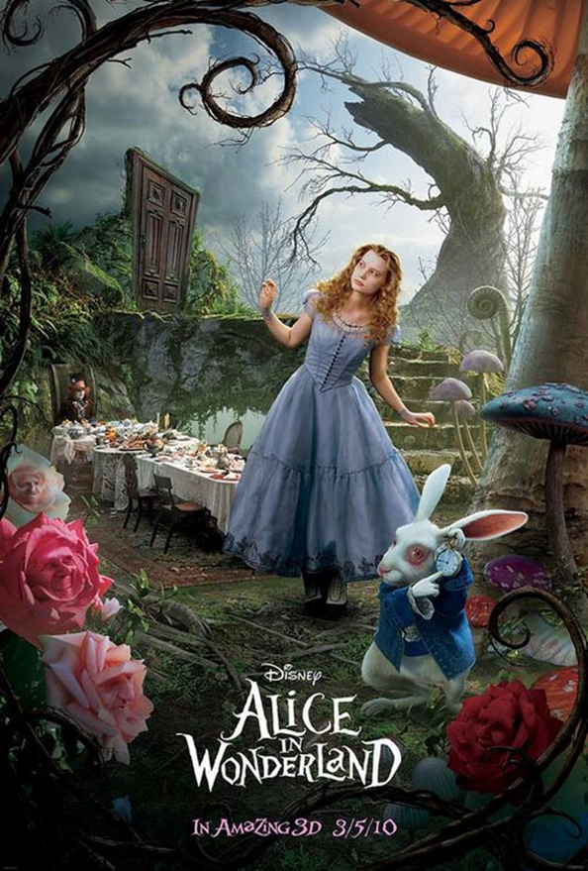
Alice in Wonderland

Slide 4
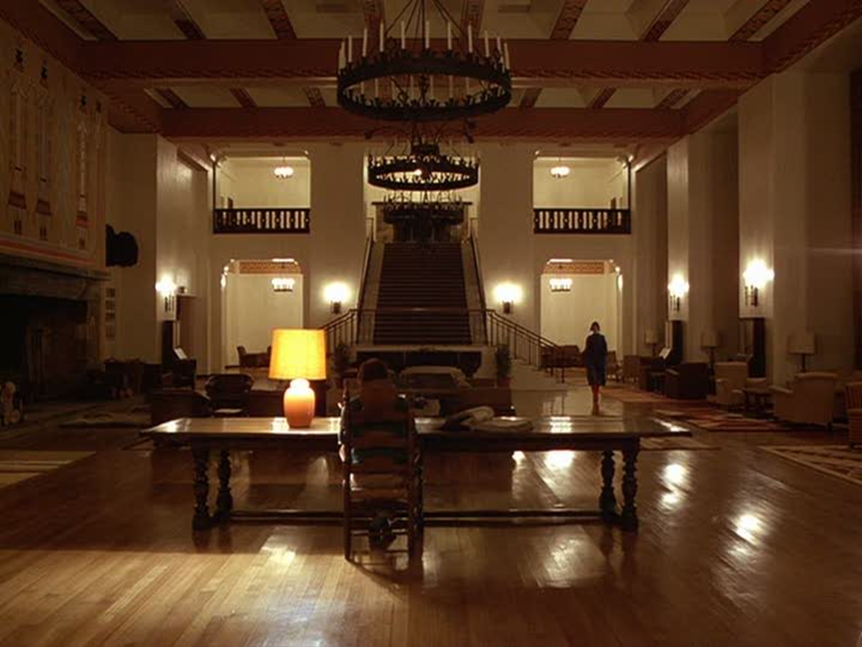
The Shining

Slide 5
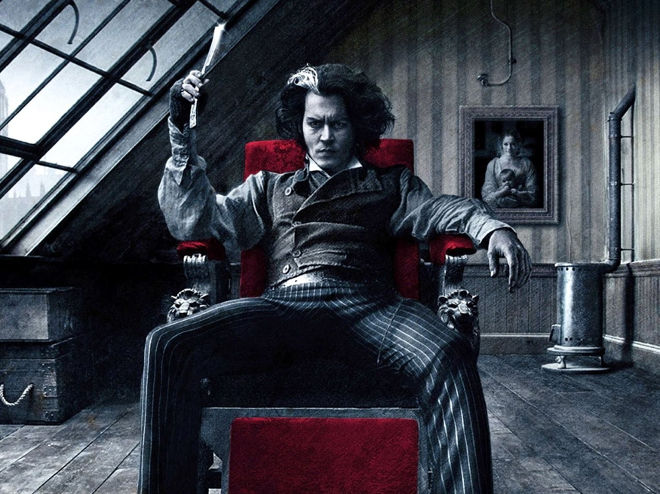
Sweeney Todd

Slide 6
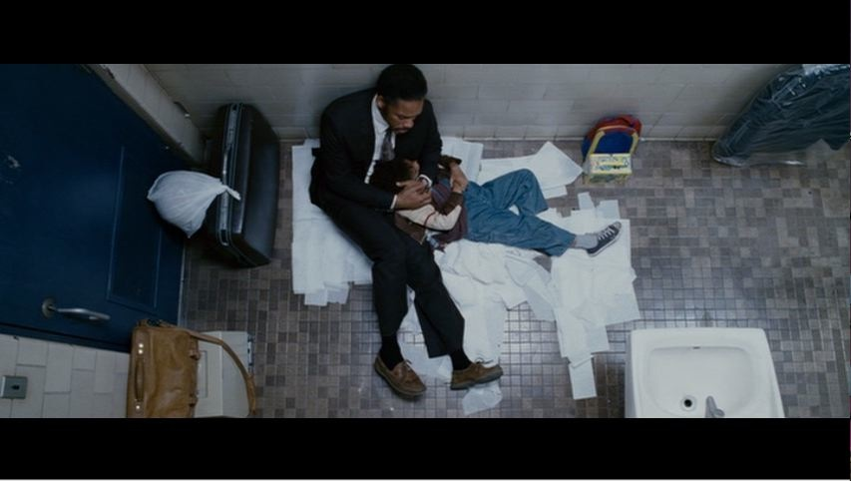
The Pursuit of Happyness

Slide 7
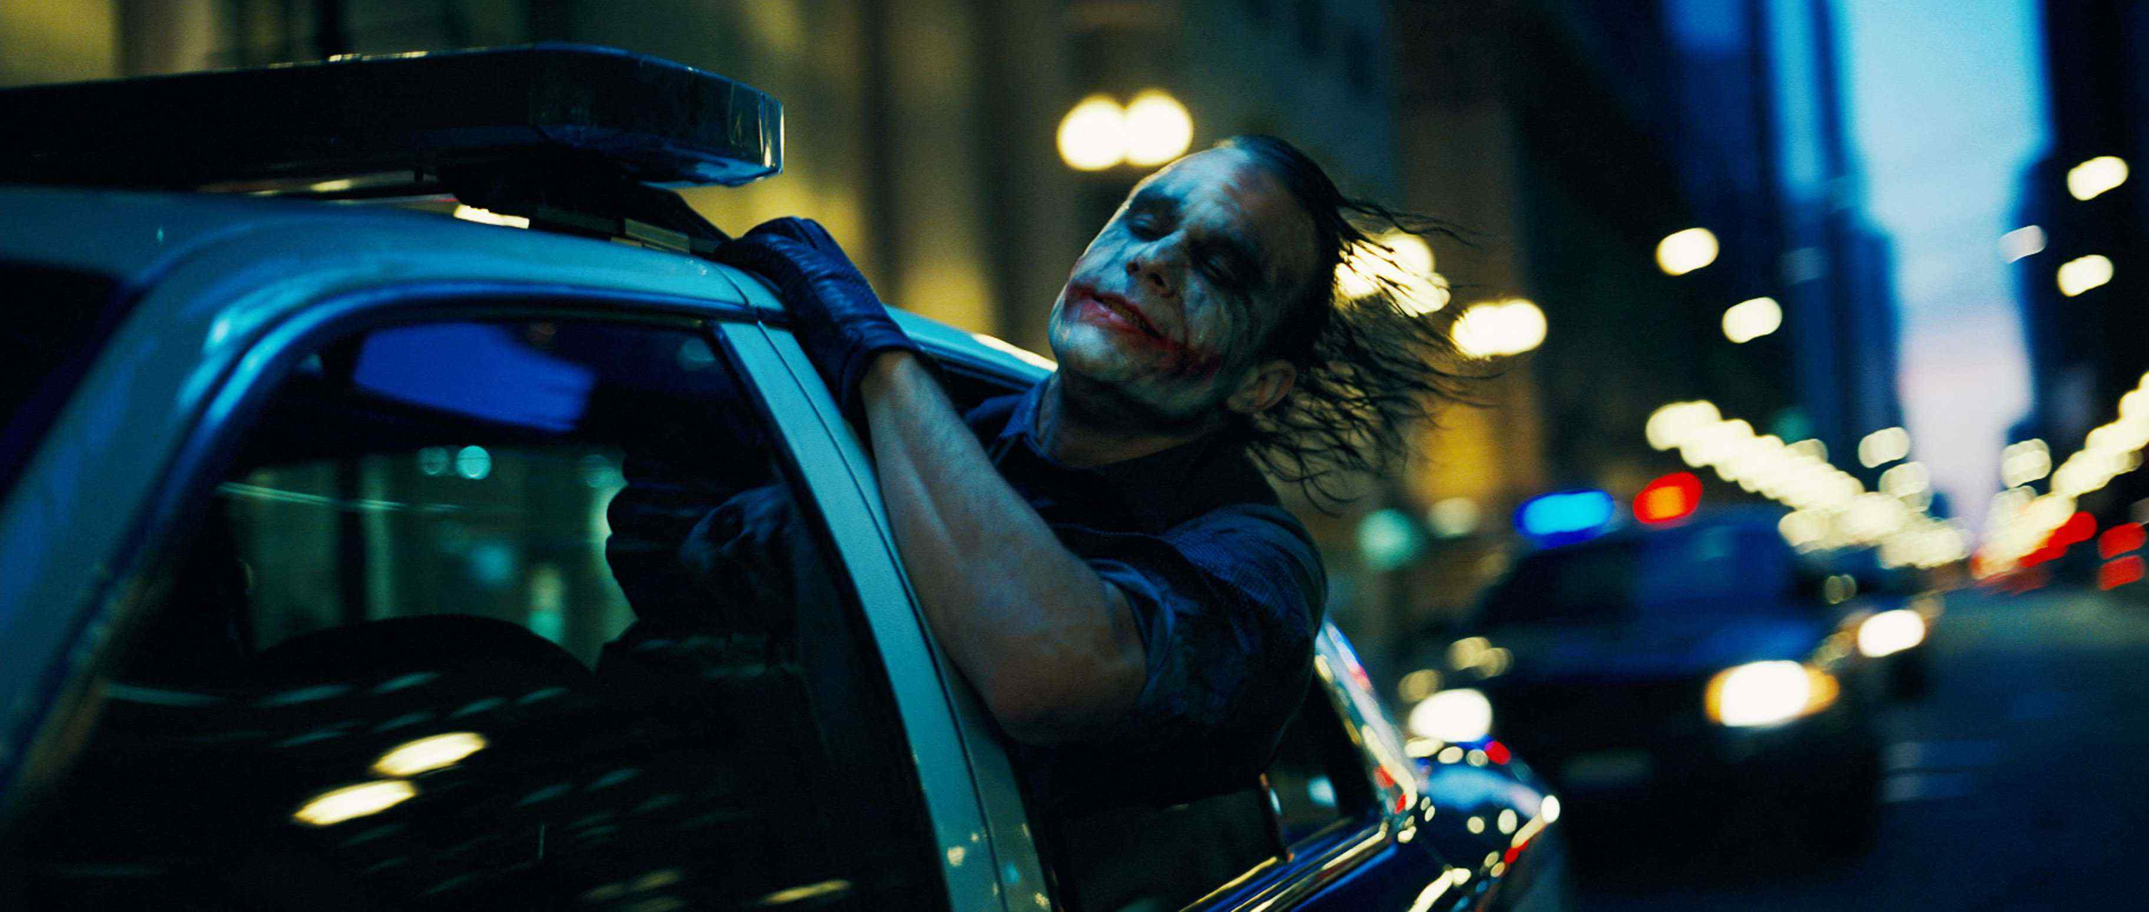
The Dark Knight

Slide 8
Mean Girls

Slide 9
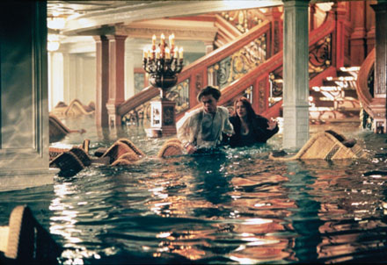
Titanic

Slide 10
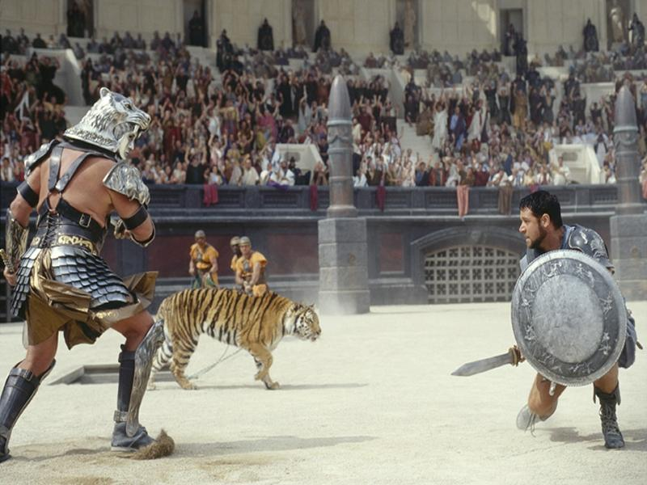
Gladiator

Slide 11
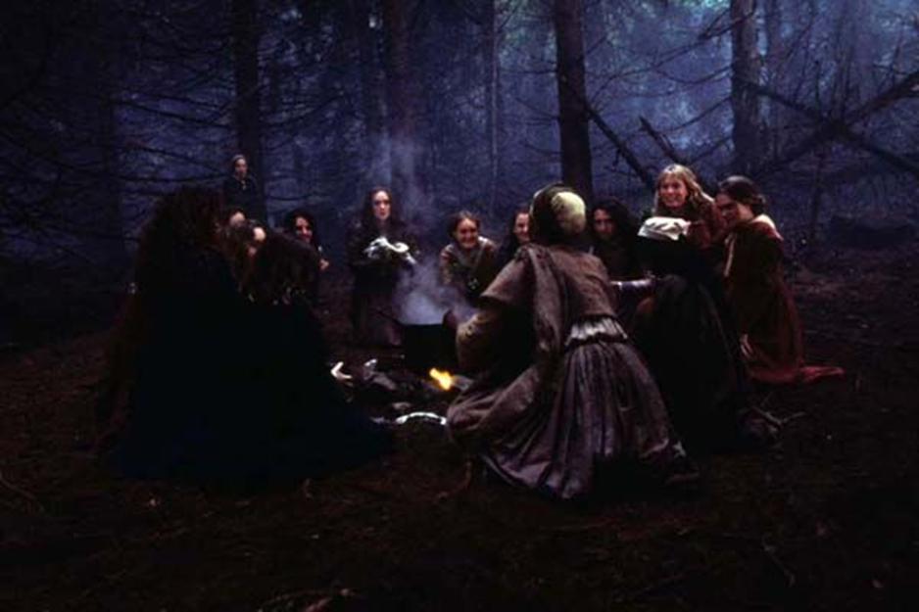
The Crucible

Slide 12
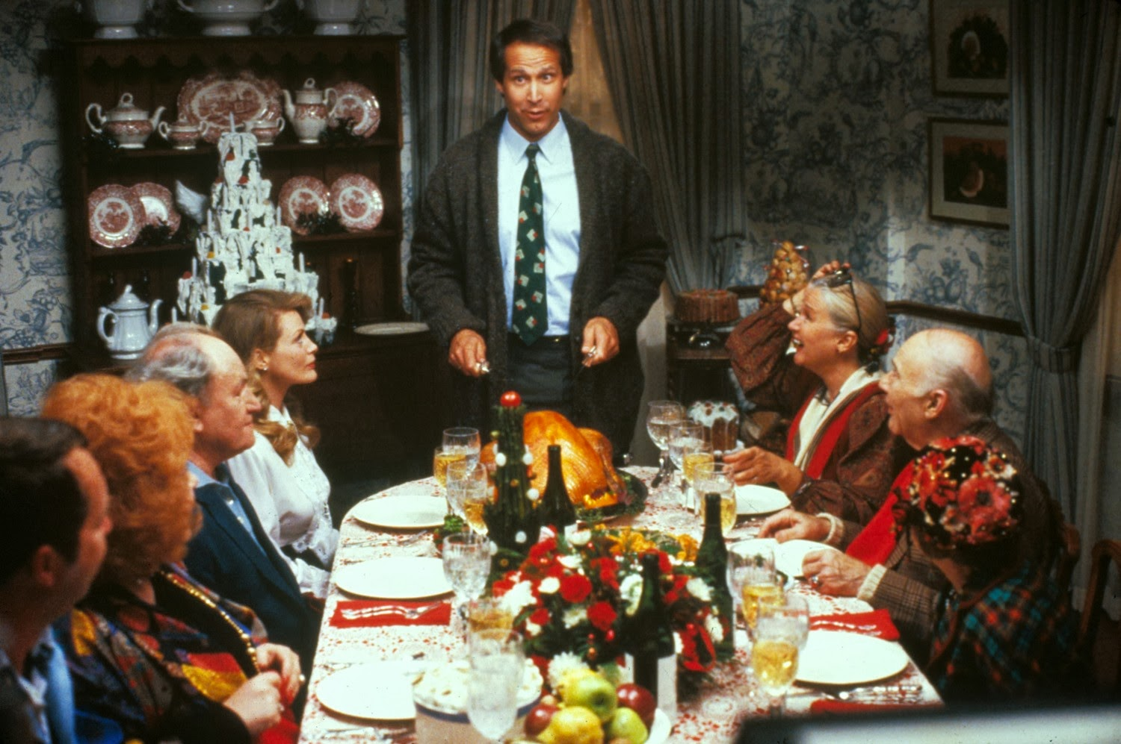
Christmas Vacation

Slide 13
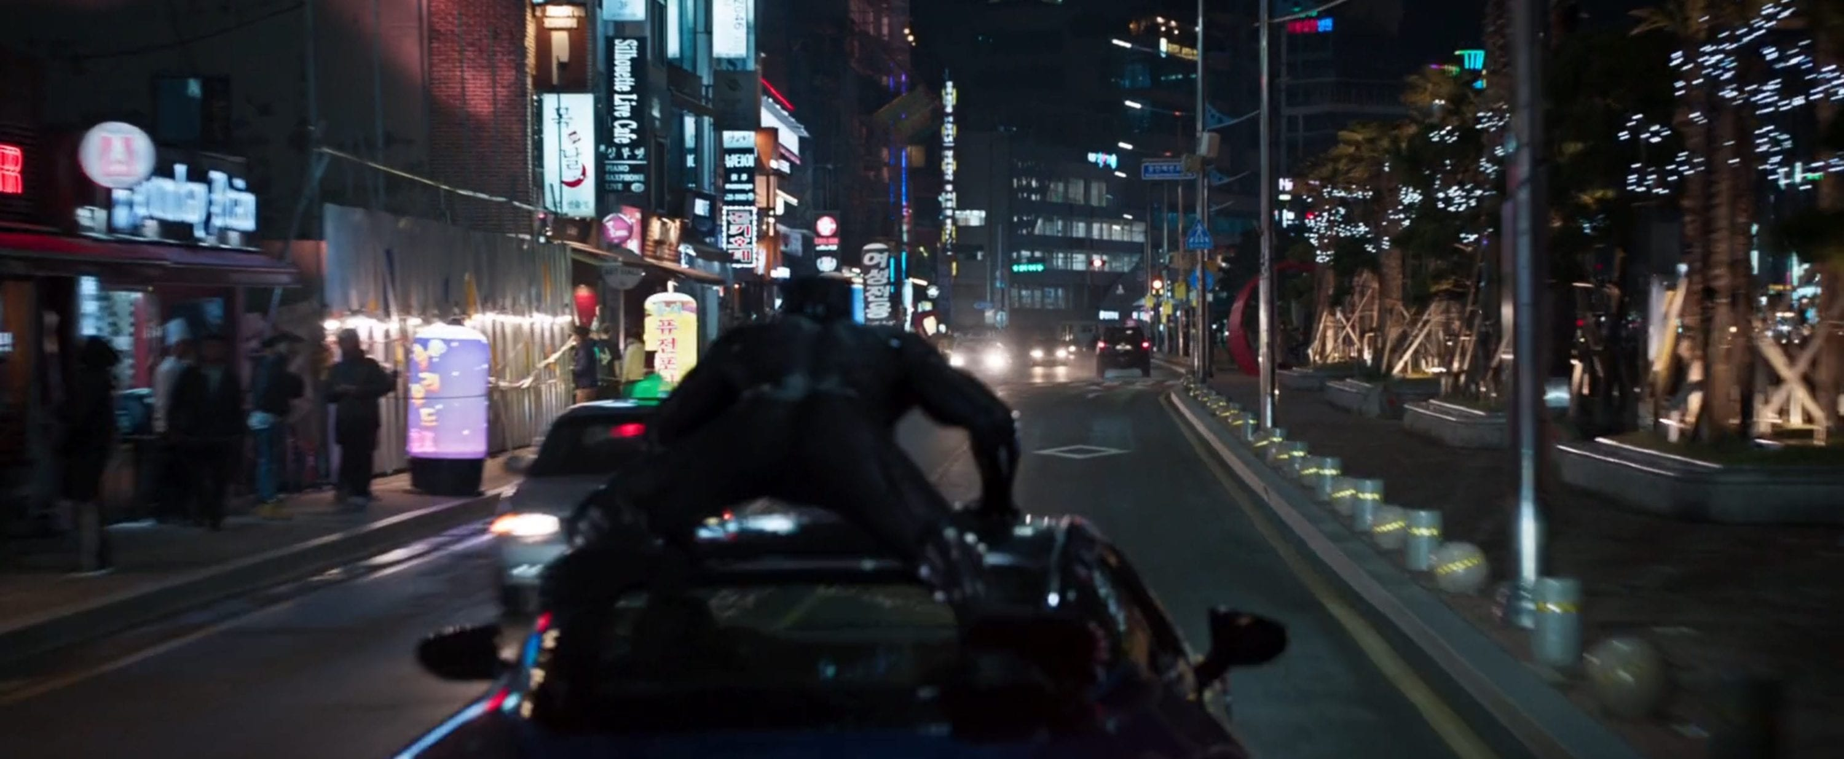
Black Panther

Slide 14
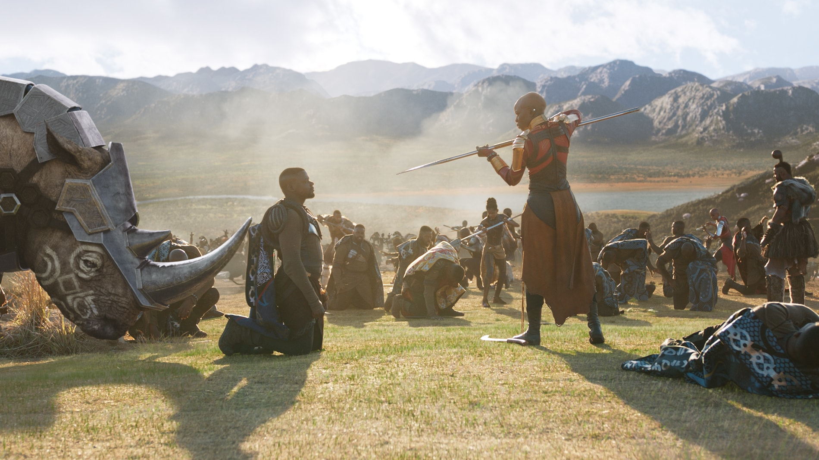
Black Panther

